Slide 1
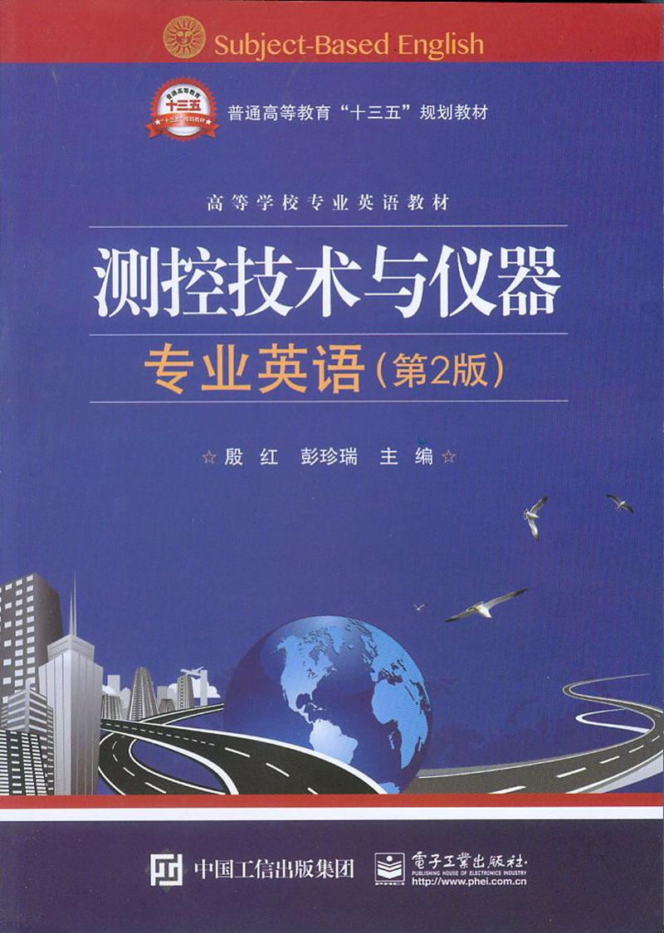
Unit7 Fieldbus

Slide 2
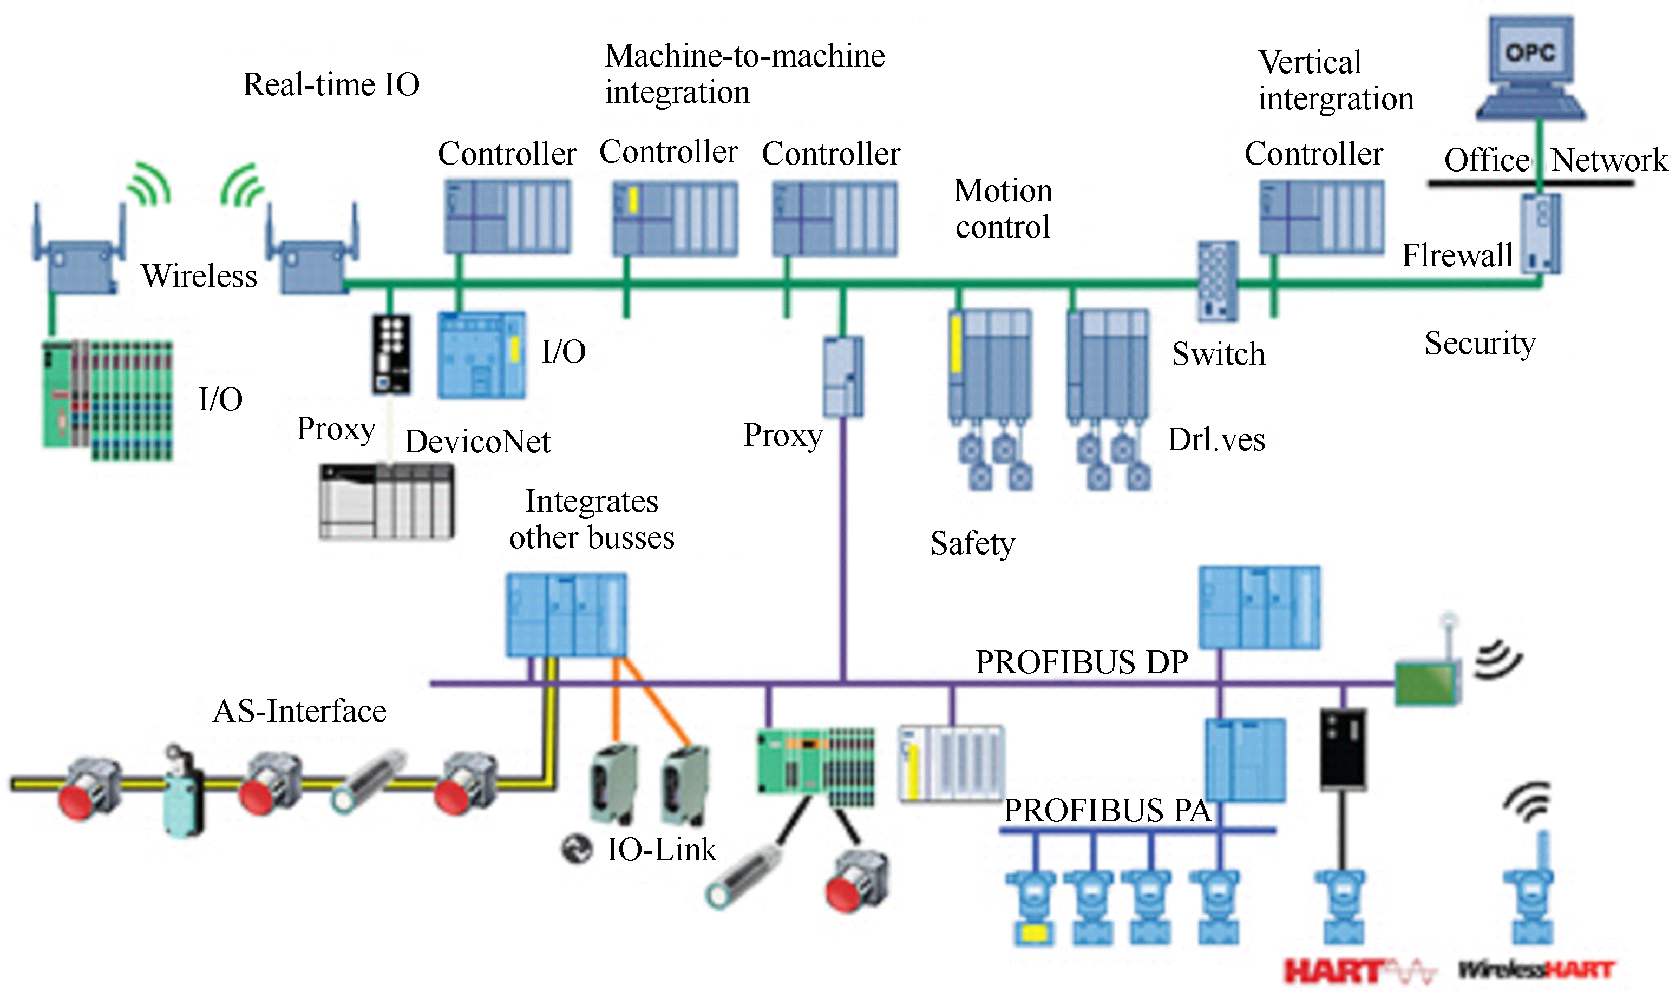
Unit7 Fieldbus

Slide 3
It’s time for a change from the 4～20mA analogue signal standard which has been used for decades as the method for communications between field（现场）devices and a central computer in industry. Fieldbus promises a cheaper, more versatile （多用途的，多功能的）and efficient system.
是改变4～20mA模拟信号的标准的时候了，它几十年来用作工业现场设备和中心计算机间的通信方法。现场总线为我们提供一种更便宜，更通用，更有效的系统。

Slide 4
What is fieldbus?
Fieldbus is a generic-term which describes a new digital communications network which will be used in industry to replace the existing 4～20mA analogue signal. The network is a digital, bi-directional, multidrop, serial-bus, communications network used to link isolated field devices, such as controllers, transducers, actuators and sensors.
现场总线是一个通用术语，它描述了一种新的数字通信网络，用于工业中代替现存的4～20mA模拟信号。这种网络是一个数字、双向、多站、串行总线的通信网络。用于连接独立的现场设备，如控制器、变送器、执行器和传感器。

Slide 5
With these devices not only will the engineer be able to access the field devices, but they are also able to communicate with other field devices. In essence fieldbus will replace centralised control networks with distributed-control networks. Therefore fieldbus is much more than a replacement for the 4～20mA analogue standard.
句中distributed-control networks意为“分布式控制系统”，也称“集散系统”。
有了这些设备，工程师不仅能够访问这些现场设备，而且还能与其他现场设备通信。实质上，现场总线将代替集散控制系统的集中控制网络。因此，现场总线不只是替代4～20mA模拟量标准。

Slide 6
The fieldbus technology promises to improve quality, reduce costs and boost（增加，提高，促进，改善，激励）efficiency. These promises made by the fieldbus technology are derived partly from the fact that information which a field device is required to transmit or receive can be transmitted digitally.
句中These promises are derived from the fact 是句子的主干。that引导的从句是the fact的同位语。That从句中，information can be transmitted是从句的主干。Which从句是information的后置定语。
现场总线技术可以提高质量，降低成本，提高效率。现场总线技术的这些优势部分源于现场设备要传输和接收的信息能进行数字化传输。

Slide 7
This would be the equivalent of the currently used 4～20mA communication scheme which requires that each device has its own communication point at the controller level, while the fieldbus is the equivalent of the current LAN-type connections, which require only one communication point at the controller level and allow multiple (hundreds) of analog and digital points to be connected at the same time.
这相当于当前使用的4～20mA通信模式，它要求每个设备在控制器级别上都有自己的通信点，而现场总线相当于当前的局域网连接，它只要求控制器级别上有一个通信点，并允许多个（上百个）模拟数字信号点与之同时连接。

Slide 8
Standards and networking
In the United States, Allen-Bradley developed standards that eventually grew into DeviceNet and ControlNet; in Europe, Siemens and other manufacturers developed a protocol which evolved into PROFIBUS.
句中DeviceNet，ControlNet和PROFIBUS都是现场总线网络标准的名称，Allen-Bradley艾伦-布拉德利公司是美国的自动化产品开发与制造商。Siemens西门子公司是德国的自动化产品开发与制造商。全句译为：在美国，Allen-Bradley开发的现场总线标准后来成为DeviceNet和ControlNet，在欧洲，Siemens和其他制造商开发的现场总线协议发展为PROFIBUS。

Slide 9
During the 1980s, to solve communication problems between different control systems in cars, the German company Robert Bosch GmbH first developed the Controller Area Network (CAN). The concept of CAN was that every device can be connected by a single set of wires, and every device that is connected can freely exchange data with any other device. CAN soon migrated into the factory automation marketplace (with many others).
在20世纪80年代，为了解决汽车不同控制系统间的通信问题，德国公司Robert Bosch GmbH首先研发了控制器局域网(CAN)。CAN总线的理念是每个设备都由一套单独的线缆连接，连接的设备都可以与其他设备自由交换数据。CAN很快被应用于工厂自动化市场中（以及其他应用场合）。

Slide 10
To understand the differences among fieldbus standards, it is necessary to understand how fieldbus networks are designed. With reference to the OSI model, fieldbus standards are determined by the physical media of the cabling, and layers one, two and seven of the reference model.
句中OSI为Open System Interconnect Reference Model的缩写，意为“开放式系统互连参考模型”。
译为：为了理解现场总线间的区别，必须理解现场总线网络是如何设计的。根据OSI参考模型，现场总线标准取决于电缆的物理介质和参考模型的第1层、第2层和第7层。

Slide 11
For each technology the physical medium and the physical layer standards fully describe, in detail, the implementation of bit timing, synchronization, encoding/decoding, band rate, bus length and the physical connection of the transceiver to the communication wires.
对每种技术，物理介质和物理层标准从细节上完全描述了如何执行位定时、比特同步、编码/解码、比特率、总线长度、收发器与通信线间的物理连接。

Slide 12
The data link layer（数据链路层）standard is responsible for fully specifying how messages are assembled ready for transmission by the physical layer, error handling, message-filtering and bus arbitration（总线仲裁）and how these standards are to be implemented in hardware.
数据链路层用于详细描述消息是如何汇编以用于物理层传输、误差处理、消息筛选、总线仲裁，以及这些标准是如何在硬件中执行的。

Slide 13
Technical committees, with representatives（代表，代理人）of many different companies, have been responsible for turning the original specifications into international ISO standards. Bury, among others, reports that work is underway（在进行中的）to implement a common fieldbus protocol.
许多不同公司的代表组成的技术委员会负责将这些原始的规范转化成国际ISO标准。Bury等报告他们正在做工作执行一种共同的现场总线协议。

Slide 14
This will entail a common set of application-layer services that can be provided regardless of the lower-layer implementation details.
这就需要有一套共同的应用层服务，而不考虑底层的执行细节。

Slide 15
The debugging and maintenance of the system will also be enhanced due to the fact that fieldbus enables online diagnostics to be carried out on individual field devices. The online diagnostics include functions such as open wire detection and predictive maintenance and simplify tasks such as device calibration.
句中open wire意为“明线，裸线”，predictive maintenance意为“预维护，预见性维修”。
由于现场总线能在单个现场设备上进行在线诊断，系统调试和维修效率提高了。在线故障诊断的功能有明线检测、预测性维修和简化设备标定等工作。

Slide 16
Although it is a major challenge trying to develop a single worldwide protocol for process control, there are currently only two real protocols for fieldbus, being ISP and WorldFIP and while there is still two protocols rather than a world standard, it is better than a possible many.
虽然试图为过程控制开发一种单独的全球协议是一个较大的挑战，但目前只有两种真正的现场总线协议，即ISP和WorldFIP，虽不是一个全球标准，但是两种协议总比更多的协议要好。

Slide 17
The user will only be required to have a limited knowledge of the management services, because some of the information generated by them will be needed if a problem occurs in the system. In fact, it should only be necessary for the user to concern themselves with the Physical and User layers.
句中management services意为“管理服务”。
用户只需要掌握有限的管理服务知识，因为一旦系统出现了问题，需要用到管理服务所给出的一些信息。事实上，用户只需要关注物理层和用户层。

Slide 18
Disadvantages
There are disadvantages to using fieldbus compared to the 4～20mA analog signal standard (or to 4～20mA with HART):
HART（Highway Addressable Remote Transducer）即HART协议，高速寻址远程变送协议。由美国ROSEMOUNT公司发起的一种智能现场设备和控制系统间通信协议的工业标准，它是过程工业中使用最广泛的通信协议。在HART协议通信中主要的变量和控制信息由4～20mA传送。

Slide 19
（1）Fieldbus systems are more complex, so users need to be more extensively trained or more highly qualified.
（2）The price of fieldbus components is higher.
（3）Fieldbus test devices are more complex compared to a high-spec（高规格，高品质） multimeter（万用表） that can be used to read and simulate analog 4～20mA signals. （4）Slightly longer reaction times with fieldbus, depending on the system.
（1）现场总线系统更复杂，所以用户需要更广泛地培训或更高的资格。
（2）现场总线部件价格更贵。
（3）现场总线测试装置比起（高品质）万用表要复杂，万用表可用于读取和仿真4～20mA模拟信号。
（4）取决于不同系统，现场总线反应时间稍微长一些。

Slide 20
（5）Device manufacturers have to offer different versions of their devices (e.g. sensors, actuators) due to the number of different (incompatible) fieldbus standards. This can add to the cost of the devices and to the difficulty of device selection and availability.
（6）One or more fieldbus standards may predominate（占支配地位 ，在……中占优势）in future and others may become obsolete（过时的，淘汰的，废弃的）.
（5）由于各种不同（不兼容）的现场总线标准，仪器制造商不得不提供各种版本的设备（如传感器，执行器）。这会增加设备的成本，增加仪表可选性和可用性的难度。
（6）一种或几种现场总线标准可能会在未来占主导地位，其他的可能会过时。当使用现场总线是，这增加了投资风险。

Slide 21
Current developments
Recently a number of Ethernet-based industrial communication systems have been established, most of them with extensions for real-time communication. These have the potential to replace the traditional field buses in the long term.
句中Ethernet-based意为“基于以太网的”，real-time意为“实时”。
译为：当前一些基于以太网的工业通信系统已经建立，它们绝大多数都扩展了实时通信功能。从长远来看，它们取代传统的现场总线成为可能。

